Slide 1
Mid-term Case Study
Research Question: How does covid-19 affect exchange rate
Hypothesis: The number of deaths caused by covid-19 and exchange rates are positively correlated.
NGO NGUYEN THANH THANG
20229549

Slide 2
Introduction Methodology Testing and Results Summary Conclusion

Slide 3
Why I chose this topic
Modern Economy
Foreign exchange rate
Covid-19 effects
International trade is important:
Increases Economic Growth
Fosters Technological Advancement
Facilitates International Trade and Investment
Disruption of Global Supply Chains
Decline in Global Trade Volumes

Slide 4
Preliminary Research
Research 1
Research 2
Research 3
The real exchange rates were driven by the number of new Covid-19 deaths rather than by the number of new infections (Kohrt et al., 2022).
COVID-19 cases and deaths negatively affect the exchange rates of both countries in the short and long run (Li et al., 2021).
Foreign exchange market efficiency failed during the COVID period, indicating the pandemic was a destabilizing event for currency markets (Azzam et al., 2023).

Slide 5
Hypothesis: the number of covid-19 deaths and a country’s exchange rate is positively correlated with each other.
Null-hypothesis: the number of covid-19 deaths and a country’s exchange rate is not positively correlated with each other.

Slide 6

A brief introduction about exchange rate
An exchange rate is the value of one currency expressed in terms of another currency. It determines how much of one currency you can get in exchange for another. Exchange rates play a crucial role in international trade, investment, and financial markets by allowing countries, businesses, and individuals to trade goods, services, and assets across borders.
5

Slide 7
The higher the base/quote ratio is the weaker the quote currency become when comparing with the base currency.

Slide 8
Methodology

Slide 9
Base Currency
Covid-19 Statistics
EUR
Number of Deaths
Quote currency
Quote Currency
Quote Currency
USD
CNY
JPY
2020-06-01
2020-06-30
2021-06-01
2021-06-30
2022-06-01
2022-06-30
2023-01-01
2023-01-30

Slide 10
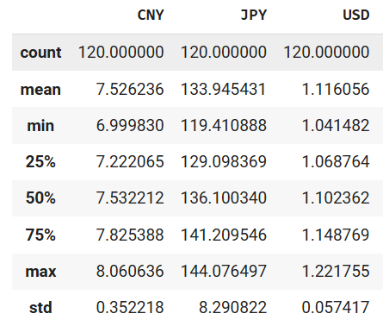
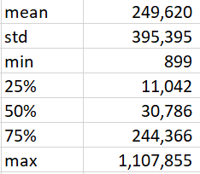
Basic Statistics
Currency exchange rates
Deaths caused by covid-19

Slide 11
Testing and Results

Slide 12
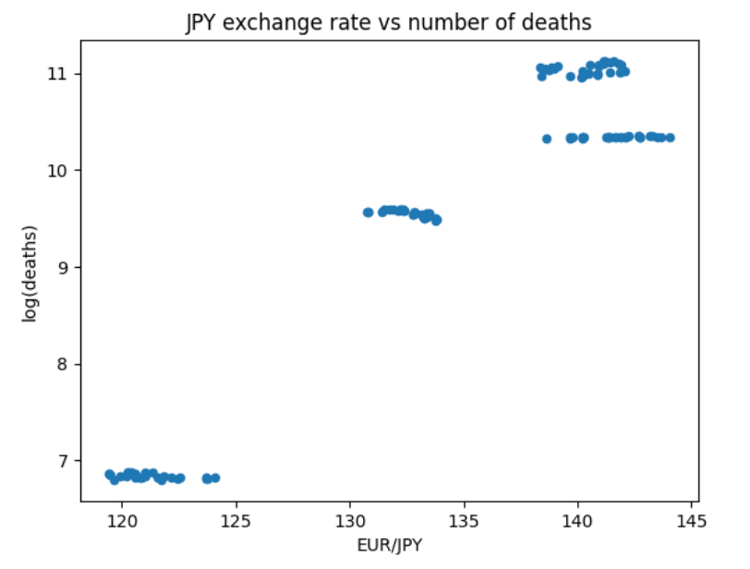
Japan
Correlation check
Scatter plot
Pearson’s Correlation coefficient
Pearson's Correlation Coefficient: 0.95
P-value: 1.8e-65
There is a strong positive correlation between the JPY and the number of covid-19 deaths

Slide 13
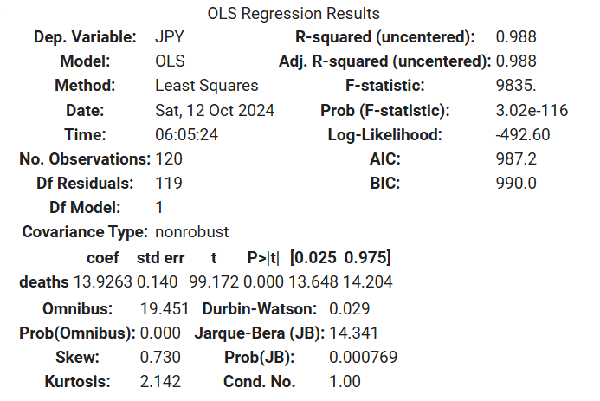
Japan
Linear Regression Model
The regression model shows there is a strong positive relationship between the number of deaths caused by covid-19 in Japan and the Japanese currency exchange rates. Since the P value is significant (<0.05) we could say that on average if log of covid-19 deaths increase by 1 unit, then the Chinese currency exchange rates would increase by 13.9 units. In other words, the Japanese currency would become weaker compared to Euro. In addition, the adjusted R-squared statistics is very high (0.98). This suggest that the number of covid-19 deaths has a strong overall effect on exchange rate.

Slide 14
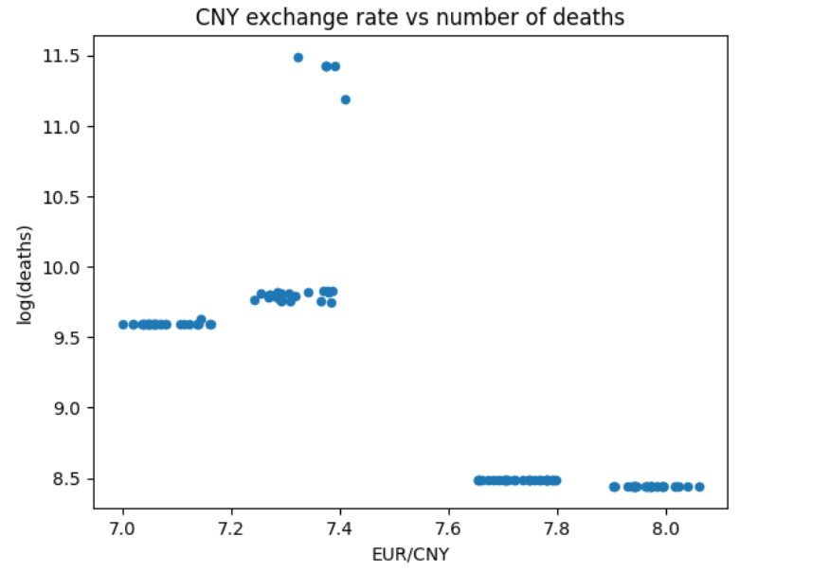
China
Correlation check
Scatter plot
Pearson’s Correlation coefficient
Pearson's Correlation Coefficient: -0.75
P-value: 5.6e-23
There is negative correlation between the CNY currency and the number of covid-19 deaths

Slide 15
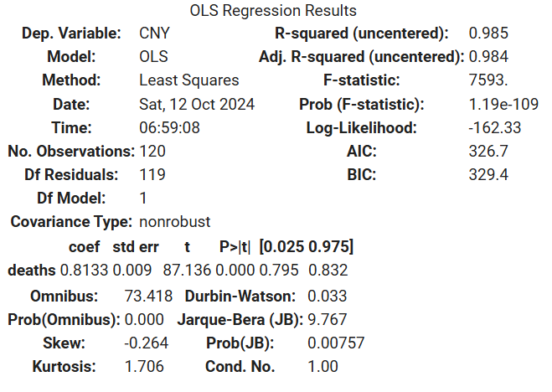
China
Linear Regression Model
The regression model suggests there is a positive relationship between the number of deaths caused by covid-19 in China and the Chinese currency exchange rates. Since the P value is significant (<0.05) we could say that on average if log of covid-19 deaths increase by 1 unit, then the Chinese currency exchange rates would increase by 0.8 unit. In other words, the Chinese currency would become weaker compared to Euro. In addition, the adjusted R-squared statistics is very high (0.98). This suggest that the number of covid-19 deaths has a strong overall effect on exchange rate.

Slide 16
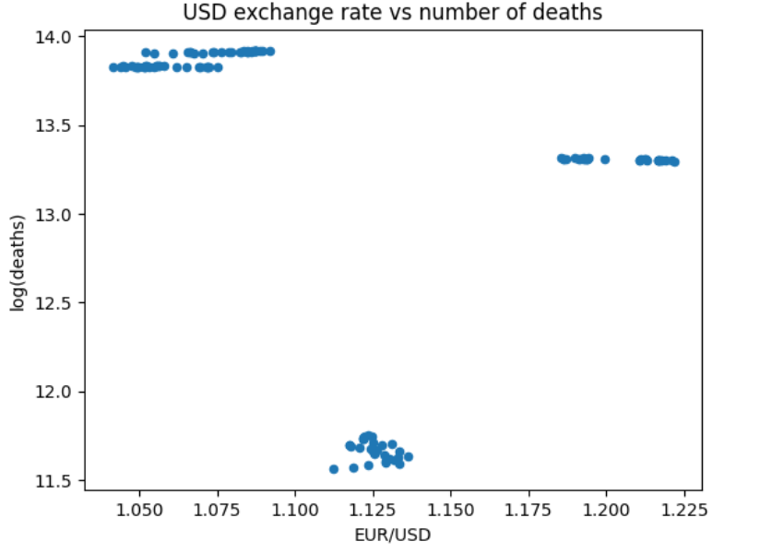
USA
Correlation check
Scatter plot
Pearson’s Correlation coefficient
Pearson's Correlation Coefficient: -0.33
P-value: 0.0001
There is negative correlation between the USD currency and the number of covid-19 deaths

Slide 17
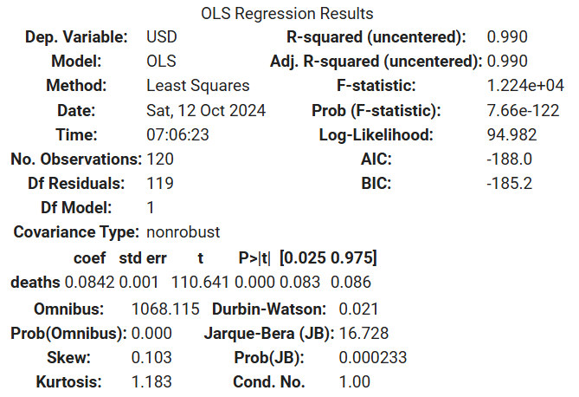
USA
Linear Regression Model
The regression model shows there is a weak positive relationship between the number of deaths caused by covid-19 in America and the American currency exchange rates. Since the P value is significant (<0.05) we could say that on average if log of covid-19 deaths increase by 1 unit, then the American currency exchange rates would increase by 0.08 unit. In other words, the American currency would become weaker compared to Euro. In addition, the adjusted R-squared statistics is very high (0.99). This suggest that the number of covid-19 deaths has a strong overall effect on exchange rate.

Slide 18
In Summary
1. The analysis produced mixed results.
2. While all the linear regression model suggest that there is a positive relationship between a country's currency and the number of covid-19 deaths, only Japan's Pearson's coefficient yields a positive relationship. By contrast, America and China's Pearson's coefficient suggest there is a negative relationship between the 2 variables.
3. As all the R-squared are > 0.9, this suggest that linear regresson is a good model to capture the relationship between the number of covid-19 deaths and exchange rates. This makes it difficult to choose between the Pearson's coefficient and the linear regression coefficient.

Slide 19
Conclusion
If we decide base of the Pearson’s Correlation Coefficient, then we would fail to reject the null hypothesis
If we decide base of the Linear Regression coefficient, then we would be able to reject the null-hypothesis
As the analysis produced mixed-results, I decided to be conservative and conclude that I fail to reject the null-hypothesis.

Slide 20
References
Azzam, I., El-Masry, A. A., & Yamani, E. (2023). Foreign exchange market efficiency during COVID-19 pandemic. International Review of Economics & Finance, 86, 717–730. https://doi.org/10.1016/j.iref.2023.03.043
COVID-19 Statistics API. (n.d.). https://covid-api.com/
Exchange Rates API - Real-Time, & Historical Currency Data. (n.d.). https://exchangeratesapi.io/
Kohrt, L., Horky, F., & Fidrmuc, J. (2022). Exchange rates in emerging markets in the first wave of the COVID-19 pandemic. Eastern European Economics, 62(2), 165–186. https://doi.org/10.1080/00128775.2022.2074461
Li, C., Su, Z., Yaqoob, T., & Sajid, Y. (2021). COVID-19 and currency market: a comparative analysis of exchange rate movement in China and USA during pandemic. Economic Research-Ekonomska Istraživanja, 35(1), 2477–2492. https://doi.org/10.1080/1331677x.2021.1959368

